Slide 1



Final Seminar : Batch # 17 , Master of Engineering ( Computer Information Engineering )
Institute of Information and Communication Technologies (IICT)
Predicting the Energy Efficiency Of Thermal Power Plant
Presented By :
GHULAM QADIR (B17-MECIE-33)
Dr. Irfan Ali Bhacho (SUPERVISOR)
Dr. Naeem Ahmed Mahoto (Co-SUPERVISOR)
Mehran University of Engineering and Technology, Jamshoro
Institute of Information & Communication Technology Jamshoro

Slide 2





01. Title
02. Literature Review
03. Background Information
04. Problem Statement
Contents
05. Aims & Objectives
06. Methodology
07. Experimental Results
08. Conclusion
09. References

Slide 3
01. TITLE
Predicting the Energy Efficiency Of Thermal Power Plant

Slide 4
02. Literature Review (1/3)
Our Research deals with machine learning’s predictive modeling for analyzing powerhouse input and output parameters to abstract pattern of optimum load with highest efficiency of power plant.
In so far some of machine learning technique have been seen in past in many industries such as power houses for prediction of important parameters which is given as under:
Paper. No | Method Description
[1] | Renewable Energy Prediction : A Novel Short-Term Prediction Model of Photovoltaic output Power . A Support Vector Machine (SVM) is used in this renewable Energy Prediction.

Slide 5
02. Literature Review (2/3)
Paper. No | Method Description
[2] | Enhance Support Vector Regression based forecast Engine to predict Solar Power Output , In this Research Improved Support Vector Regression (ISVR) Model is used for prediction Purpose.
[3] | A Wavelet Neural Network Based Model with Ridge Regression is used in China’s Power Generation industry for Prediction Drive.
[4] | The Statistical model ARMAX for forecasting power output from a photovoltaic system is used. The ARMAX used exogenous inputs for forecasting power output.

Slide 6
02. Literature Review (3/3)
Paper. No | Method
[5] | The DEA Integrated ISM approach is applied in energy efficiency analysis of Chinese ethylene industry in the petrochemical field .
[6] | The Convolution Neural Networks approach is used for predicting the boiler’s operating performance.
[7] | A comparative analysis of three modeling techniques for prediction of electricity energy consumption was presented.
[8] | A Neural Network Method for power prediction of wind power plant has been used. Neural Network was trained on historical data of wind speed

Slide 7
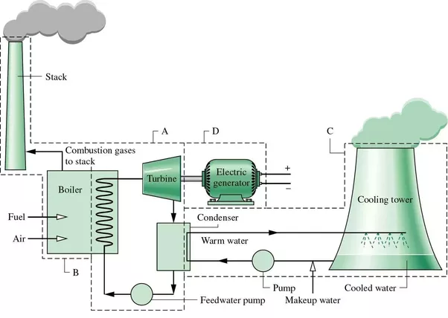
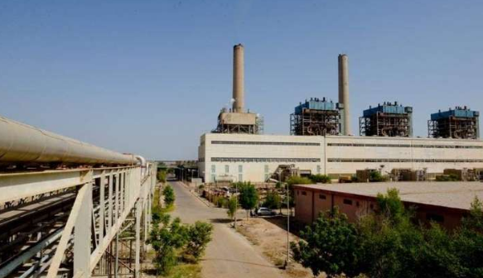
03. Background information (1/2)
Jamshoro Power plant have four power generating units with total rated capacity 880 Mega Watt (MW).
Right Side Shows Process of Power Generation , left side snap shows 4 power Generating Units.

Slide 8
03. Background information (2/2)
Accumulated Gross Generation of all four Units depends upon either Gas or RFO and Produce Generation in KWH.
Auxiliary Consumption is the amount of Electricity in KWH required to start the offline Power Unit; it serves as backup power for primary power source at the plant. Arranged from Own System or Imported from Grid of NTDC.
Net Electric Output (NEO) is obtained by subtracting auxiliary load from Gross Generation of plant. Net electric output (NEO) depend upon 3 input parameters. I.e. Consumption of RFO oil, the consumption of Natural Gas, Consumption of Quality Water in form of steam to run the turbine for power generation.
Gross Generation (KWH) | Auxiliary consumption |  |  | NEO (KWH)
 | Own System (KWH) | Imported 220/132 KV Grid (KWH) | Total Aux (KWH)
A | B | C | D = B+C | E=A-D

Slide 9
04. Problem Statement
At present data is collected Manually from powerhouse generators (Power Generating Units Features),Weight bridge system(RFO Features), Installed Gas Meters (Gas Features) & TIMS Systems for computation of efficiency for previous months.
Different Sources of Data needs to be integrated at one point as per our required format is a painstaking for model building.
As this process is manual So it contains typo mistake , null values, human error, outliers and other problems with data which may effect performance of Model.
Based on available resources , There is dire need to predict the efficiency for upcoming months.
Management may take decision in advance. Pre-planned generation can be proposed for devising Energy Policy to meet the national Demand.

Slide 10
05. Aims & Objectives
Aim:
Determination of Efficiency & Its parameters of Thermal Power Plant.
Objectives
To Collect data (Main Resource).
To Format Data as per our need and Pre-processing
To Explore various predicting techniques.
To Evaluate the method.
To Analyze the outcome.
To Recommend Energy Efficiency Parameters.
Resource Discovery
Data pre-processing
Knowledge Discovery
Efficiency Analysis

Slide 11
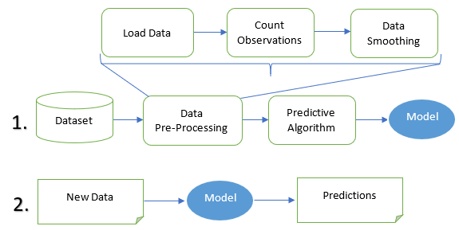
06. Methodology (1/6)
The basic scenario of our proposed approach for prediction is given in Fig. 1 that is used for forecasting the efficiency of plant.
Data is divided into training dataset and testing dataset.
Aim: To predict efficiency of plant

Slide 12
06. Methodology (2/6)
Objectives:
The methods consist of instances data preprocessing,
building model and predictions.
So, we are concerned with the data for our research for a mathematical modeling through algorithms ,
performance evaluation of algorithms & Suggestion of best fit model.
Principle component Analysis (PCA).
In order to achieve our goal , the dataset is prepared by repeating of sub steps load data, count observations, data smoothing technique.
The Refined data is supposed to be completed as training data and free from outliers is feed to the predictive algorithms for learning & model building.

Slide 13
06. Methodology (3/6)
The trained model is tested on testing data & result is compared with manual data in which highest accuracy of model is checked as per steps given below:
Data preprocessing :
We used four years of dataset of Jamshoro thermal power plant. (Available in Next Slide)
The data set were having a lot of errors, null values, invalid data and outliers
Load Data:
When data properly prepared , it was transformed into comma separated value format as the need of machine learning algorithms for applying remaining preprocessing techniques over data.
In our case we load this comma separated values(CSV) data file for machine learning algorithms for predictions
Count observations :
The Powerhouse Dataset have 30 important data items and related four years observations, a large dataset which has been properly verified by data mining techniques.

Slide 14
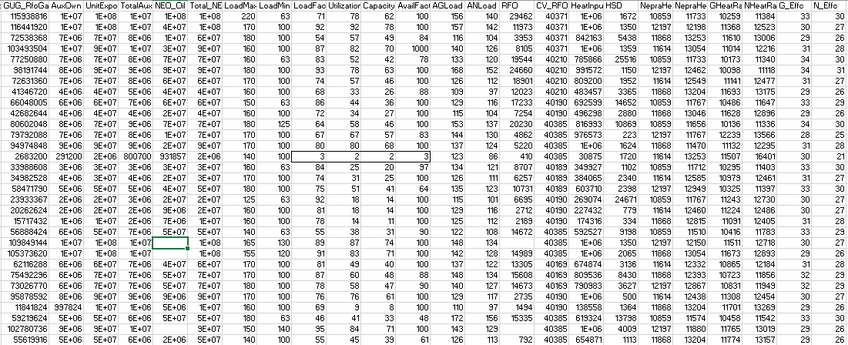
Outliers
Missing Values

Slide 15
06. Methodology (4/6)
Data Smoothing:
Data outlier deceive the training process of algorithms in which accuracy of model is compromised [9]
The outliers are datapoint lie outside of the overall pattern of distribution and prominent to catch through statistical measure such as mean , variance and correlation methods.
Outlier occurs in dataset due to human or mechanical error or by replacing missing value in the form of extreme high and low values in dataset.
Building model :
In order to train our predicting model we have implemented Linear Regression approach , KNN , Dimensional reduction algorithms i.e Random forest & Principal component analysis.

Slide 16
06. Methodology (5/6)
Learning Models Used In our Research Work
1). Linear regression model (Appendix-A)
The Purpose of Linear Regression is to predict the value of dependent variable(Outcome) over one or more independent variable (Features)
2). K N N ( K nearest neighbors) (Appendix-B)
KNN is simple & Easy to use Supervise Machine Learning Algorithm used to solve for both Classification and regression Problems.
3.a) Random forest (Appendix-C)
Random Forest Searches the best features among a random subset of features . It is fast , gives better performance and do not overfit
3.b) Principal component analysis (Appendix-C)
In a large pool of data . It reduces number of variables and Extract Important one and reduce high dimension of data which simplifies complexity.

Slide 17
06. Methodology (6/6)
Predictions :
We applied training data on each of above prediction models for training and learning.
After training phase , we apply testing data for prediction purpose.
Test Score is obtained by computing RMSE, MAE and R2, which is the performance measure of prediction models.
We used Random Sampling by splitting 5 Random samples on 75% training data. The performance measure of each model is shown in table II. Of experimental results in next Slide.

Slide 18
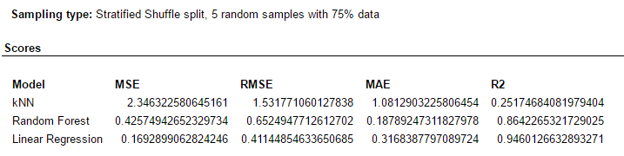
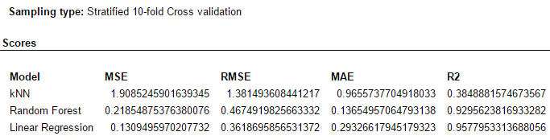
07. Experimental results (1/4)
Linear regression model is reaching 94% accuracy in Random Samples and achieving 96% accuracy in cross validation as shown in Table

Slide 19
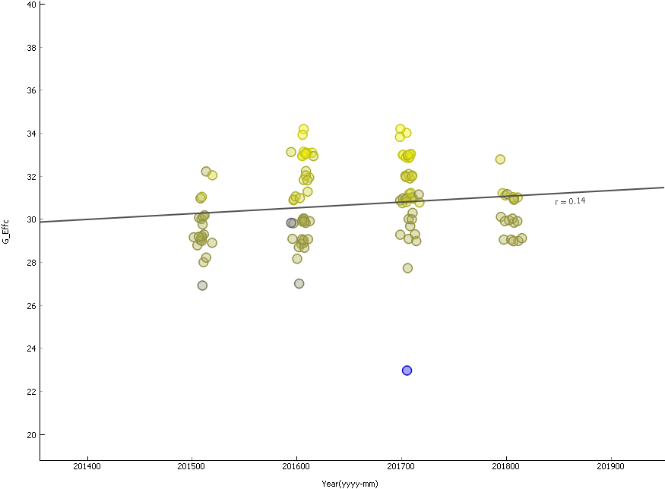
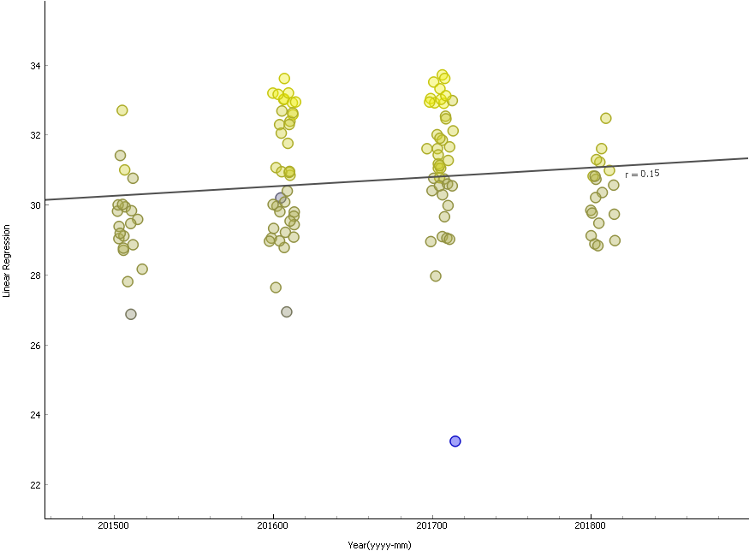
07. Experimental results (2/4)
Gross efficiency on temporal data
Prediction of Gross efficiency on
Linear Regression

Slide 20
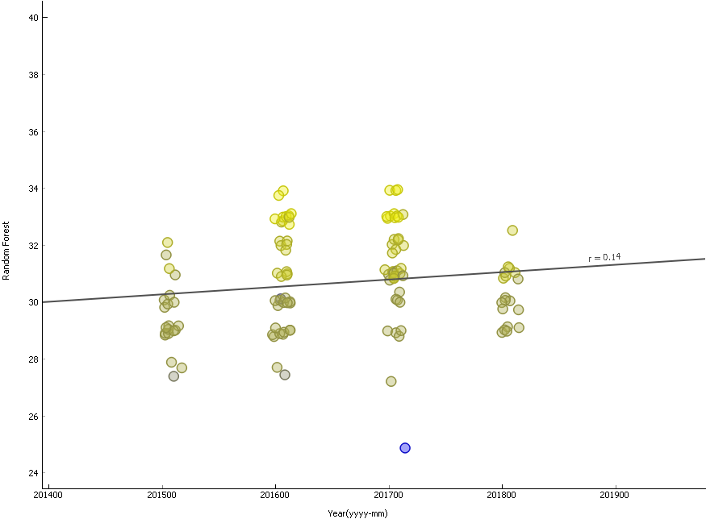
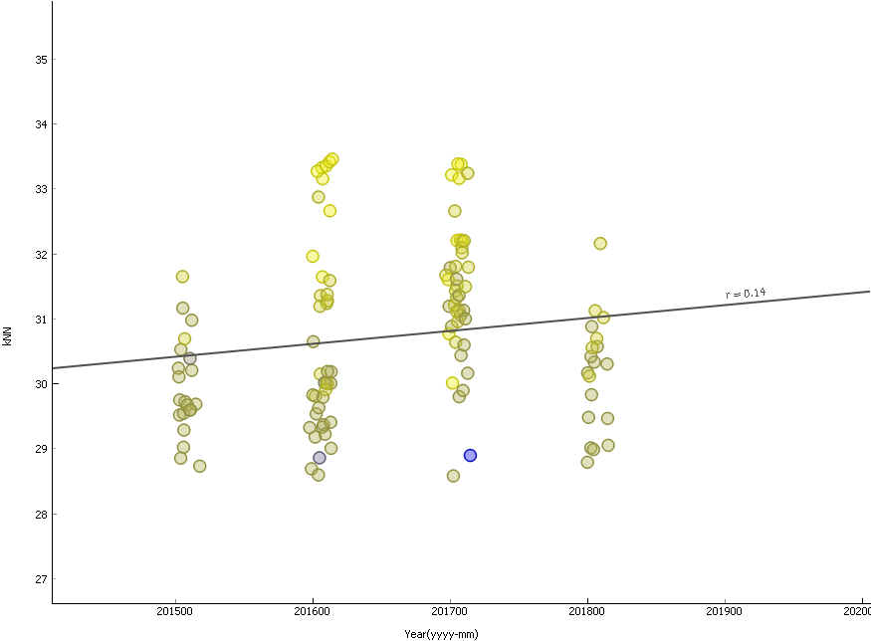
07. Experimental results (3/4)
Prediction of Gross efficiency on Random
Forests model
Prediction of Gross efficiency on
KNN model

Slide 21
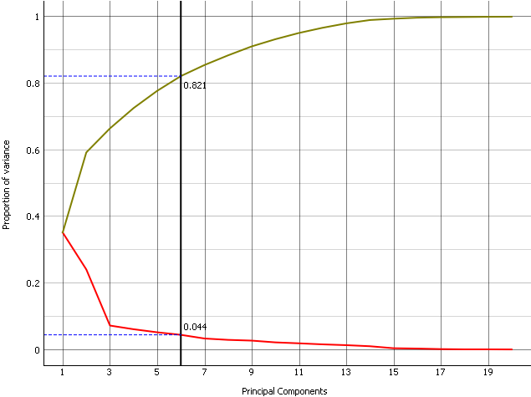
07. Experimental results (4/4)

Slide 22
08. Conclusion (1/2)
This paper presents the method of predicting Energy Efficiency of thermal Power Plant. The Plant’s Temporal Data supplied to algorithms for model building , In our Case we used linear Regression , K Nearest Neighbor (KNN), Random Forests and PCA. The Linear Regression Model was a best fit model for prediction of efficiency of power plant. The maximum accuracy achieved by the model was 96%
The Insight of our research is that efficiency has improved as per attaining the value of optimum Gross Generation. The proposed model for future prediction in our test case is linear regression model which has achieved expected results as compared to the measured available data.

Slide 23
08. Conclusion (2/2)
Publication
G. Qadir, D. I. Bhacho and D. N. A. Mahoto, "Predicting the Energy Efficiency of Thermal Power Plant," 2020 3rd International Conference on Computing, Mathematics and Engineering Technologies (iCoMET), Sukkur, Pakistan, 2020, pp. 1-6, doi: 10.1109/iCoMET48670.2020.9073874.
Published in : 2020 3rd International Conference on Computing, Mathematics and Engineering Technologies (iCoMET)
Publisher : IEEE
Date of Publication : 29-30 Jan. 2020

Slide 24
9. References (1/2)
[1]. Li, Ling-Ling, et al. "Renewable energy prediction: A novel short-term prediction model of photovoltaic output power." Journal of Cleaner Production 228 (2019): 359-375.
[2]. Shang, Chuanfu, and Pengcheng Wei. "Enhanced support vector regression based forecast engine to predict solar power output." Renewable energy 127 (2018): 269-283.
[3]. Zhao, Weibo, and Dongxiao Niu. "Prediction of CO2 emission in China’s power generation industry with gauss optimized cuckoo search algorithm and wavelet neural network based on STIRPAT model with ridge regression." Sustainability 9.12 (2017): 2377.
[4]. Li, Yanting, Yan Su, and Lianjie Shu. "An ARMAX model for forecasting the power output of a grid connected photovoltaic system." Renewable Energy 66 (2014): 78-89.
[5]. Han, Yongming, et al. "Energy efficiency analysis based on DEA integrated ISM: A case study for Chinese ethylene industries." Engineering Applications of Artificial Intelligence 45 (2015): 80-89.
[6]. Kljajić, Miroslav, Dušan Gvozdenac, and Srdjan Vukmirović. "Use of Neural Networks for modeling and predicting boiler's operating performance." Energy 45.1 (2012): 304-311.
[7]. Tso, Geoffrey KF, and Kelvin KW Yau. "Predicting electricity energy consumption: A comparison of regression analysis, decision tree and neural networks." Energy 32.9 (2007): 1761-1768.
[8]. Liu, Ziqiao, et al. "Wind power plant prediction by using neural networks." 2012 IEEE energy conversion congress and exposition (ECCE). IEEE, 2012.
[9]. Guo, Ying, et al. "Intelligent outlier detection for HVAC system fault detection." 10th International Conference on Healthy Buildings, Brisbane, Australia. 2012.
[10]. Obermeyer, Ziad, and Ezekiel J. Emanuel. "Predicting the future—big data, machine learning, and clinical medicine." The New England journal of medicine 375.13 (2016): 1216.

Slide 25
9. References (2/2)
[11]. Erfani, Sarah M., et al. "High-dimensional and large-scale anomaly detection using a linear one-class SVM with deep learning." Pattern Recognition 58 (2016): 121-134.
[12]. Cunningham, John P., and Zoubin Ghahramani. "Linear dimensionality reduction: Survey, insights, and generalizations." The Journal of Machine Learning Research 16.1 (2015): 2859-2900
[13]. Jones, Zachary , and Fridolin Linder. “ Exploratory Data Analysis using Forest tree.” Prepared for 73rd annual MPSA conference .2015.
[14]. Isaac, Ebenezer, K. S. Easwarakumar, and Joseph Isaac. "Urban landcover classification from multispectral image data using optimized AdaBoosted random forests." Remote sensing letters 8.4 (2017): 350-359.
[15]. Lahouar, Ali, and J. Ben Hadj Slama. "Day-ahead load forecast using random forest and expert input selection." Energy Conversion and Management 103 (2015): 1040-1051.
[16] Chen, Jianguo, et al. "A parallel random forest algorithm for big data in a spark cloud computing environment." IEEE Transactions on Parallel and Distributed Systems 28.4 (2016): 919-933.
[17] .Harrou, Fouzi, et al. "Improved principal component analysis for anomaly detection: Application to an emergency department." Computers & Industrial Engineering 88 (2015): 63-77
[18]. Jolliffe, Ian T., and Jorge Cadima. "Principal component analysis: a review and recent developments." Philosophical Transactions of the Royal Society A: Mathematical, Physical and Engineering Sciences 374.2065 (2016): 20150202.

Slide 26
Appendix-A
1). Linear regression model
This approach of building model estimate the level of correlation between input and output parameters of dataset [11].
The linear algorithm map the data points to the find the best fit line to model the data.
Mathematical representation of a straight line is y = a+ bx ,
where y is dependent variable and x is independent variable ,
b is the slope of straight line or gradient where a is the constant or a biased term y-intercept.

Slide 27
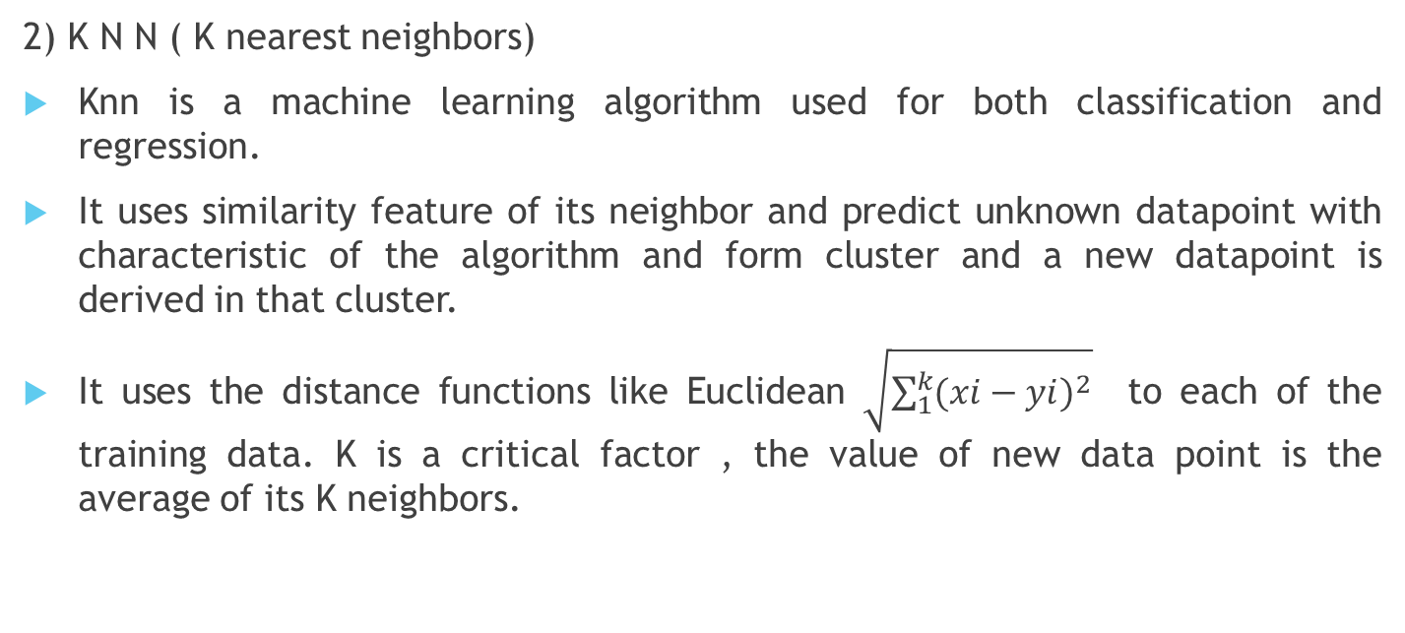
Appendix-B
2) K N N ( K nearest neighbors)
Knn is a machine learning algorithm used for both classification and regression.
It uses similarity feature of its neighbor and predict unknown datapoint with characteristic of the algorithm and form cluster and a new datapoint is derived in that cluster.
It uses the distance functions like Euclidean $\sqrt{\sum_{1}^{k}{{(xi−yi)}^{2}}}$ to each of the training data. K is a critical factor , the value of new data point is the average of its K neighbors.

Slide 28
Appendix-C
3.a) Random forest)
Random forest build forests of multiple decision trees and combine together for stable and accurate prediction tasks , the training phase uses bagging method which decrease the variance in predictions [13].
It is easy to use algorithm and produce accurate outcome most of the time. Random forest is used for either purpose i.e. classification and regression tasks [14].
3.b) Principal component analysis )
PCA is using the method of variance , covariance structure of set or variables through linear combination for dimension reduction[17]
Highlight components which have major role in producing prediction outcome of algorithm. PCA increase interpretability along with minimum information loss [18].

